Slide 1
Building a Quality Resume
Advisement

Slide 2
What do employers want?
Employers want...
Professionalism
Written and verbal communication
Conflict resolution
Soft Skills
Take initiative
Responsibility
Team work
Reliable
They are willing to train the right person!
Notes:
Professionalism--What will you contribute in addition to the skills to perform your duties? Do you show that you take pride in your work? Do you look at the big picture and understand how you fit into the entire organization? How will you help benefit the organization?
Written and verbal communication skills--You will be working with clients or other team members. Can you communicate your thoughts efficiently and effectively with them? Do you have the same professionalism in person as well as on the phone? Email? How are your presentation skills in formal and informal settings?
Conflict resolution--How do you handle difficult situations? Can you confront, in a civil way, face to face to discuss a miscommunication or a problem within your team?
Soft Skills--Can you show that you are a self-starter, self motivated, not afraid to take the lead on projects, know how to delegate duties, can be counted on as a team member?

Slide 3
What do you leave out?
Check your ego!
Life history
Excuses
Inconsistencies
Article:
8 Flags Employers See On Your Resume

Slide 4
Your resume should be...
Filled with C’s...
Clean
Clear
Concise
Consistent
Convincing Content

Slide 5
You have...
Approximately 7 seconds to catch your potential employer’s attention with the information in your resume...
Choose wisely!!

Slide 6
Must haves...
All resumes should include the following:
Contact Information
Goal/Objective
Education
Work Experience
References

Slide 7
Optional:
Awards
Honors
Achievements
Volunteer
Activities that show leadership
Additional skills not already highlighted

Slide 8
Contact Information
Full Name
Address
City, State, Zip Code
Telephone
Email

Slide 9
Contact Information
Don’t
Use an inappropriate email
partyfungirlusa@gmail.com
You never need to put personal information on a resume
Height Weight Passwords
Race Religion Marital Status

Slide 10
Contact Information
Example:
John Smith
123 School Street
Kiel, WI, 53042
(555) 123-4567
jsmith@gmail.com

Slide 11
Objective/Goal
Write a clear, concise statement of the specific purpose
Example:
A customer service position
in the retail industry

Slide 12
Objective/Goal
Don’t
Write a vague statement
Example:
“A position with growth potential”
“A challenging position in a stable company”

Slide 13
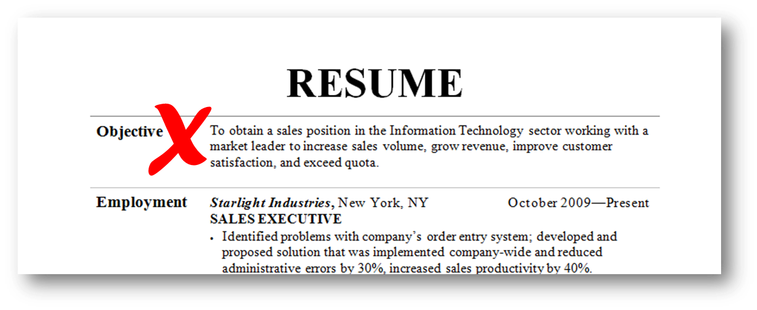
Objective/Goal
Example:

Slide 14
Education
List all education/training, beginning with your most recent
Name of the school
Dates attended
If you are a recent grad with little work experience, you may want to list the following:
GPA Specific Course Work Honors

Slide 15
Education
Don’t
List a poor GPA
List every class you have taken
Include your grade/middle school
As you achieve higher education, high school may not be necessary either

Slide 16
Education
Example:

Slide 17
Work Experience
Include the following:
Company name
Dates of employment
Job title
Describe your duties skills and responsibilities
Refer to examples
Notes:
In the description of your duties, skills and responsibilities, keep the following in mind:
State your major accomplishments, achievements and skill area
Start each with an action verb; try to keep each to 1-2 lines
Bullet your list
Give specific results to show your qualifications
List your most important accomplishment first

Slide 18
Work Experience
Don’t
Put every job/duty you were required to do at each company

Slide 19
Work Experience
Example:

Slide 20
Other Skills
You may include the following, possible each as a separate section:
Special Skills
Activities
Volunteer Work
Awards, Honors, or Achievements

Slide 21
Other Skills
Don’t
Repeat something used in another section
List everything you have ever been involved in
Use information that you cannot tie back to the position for which you are applying

Slide 22
References
List 3-5 people that know you and your work ethic
Teachers
Co-workers
Clients
Provide their contact information
Request permission before using someone

Slide 23
References
Don’t
Put “References Upon Request”
Include relatives
Use a person as a reference without permission

Slide 24
References
Example:

Slide 25
A Good Resume...
Gives your potential employer a great first impression of you...
It MUST...
Be error free
Give an honest, positive introduction of you
Showcase how you will be an asset to them
Impress the employer to offer an interview

Slide 26
Resources
Video
Harvard professor speaks about resumes
Sample Resumes
Student with work experience
Student with no work experience

